Slide 1



Centre For Innovation
Webops and
Blockchain club
Summer school 2024

Slide 2

Session 2: UI/UX design and
Git
Table of Content
1. What is UI/UX design?
2. Guidelines to create a interactive website
3. Platforms for designing a website
4. What is Git?
5. Commands in Git
6. What is GitHub?

Slide 3
WHAT IS UI/UX DESIGN?
UI : User Interface
Focuses on the visual, interactive elements of a product to create aesthetically-pleasing interfaces.
UX : User x

Slide 4
WHAT IS UI/UX DESIGN?
UI : User Interface
Focuses on the visual, interactive elements of a product to create aesthetically-pleasing interfaces.
UX : User Experience
Focuses on creating a seamless and meaningful user experience by understanding user needs, conducting research, and designing intuitive interfaces

Slide 5
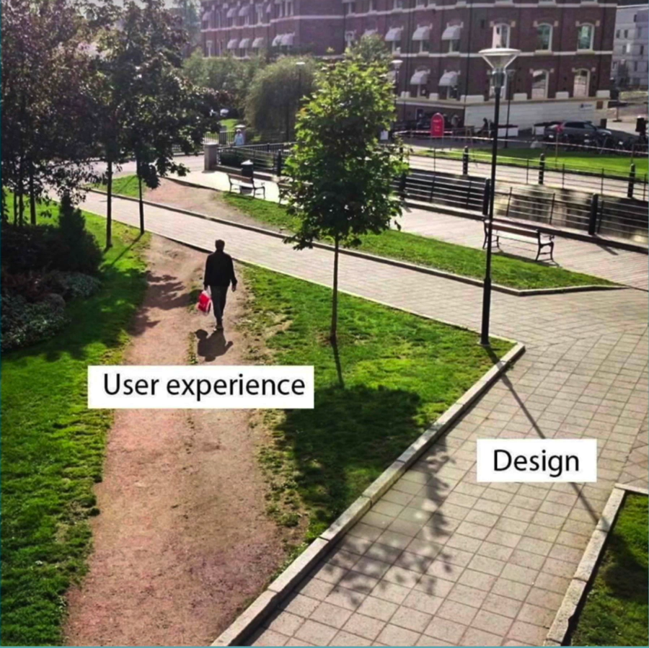
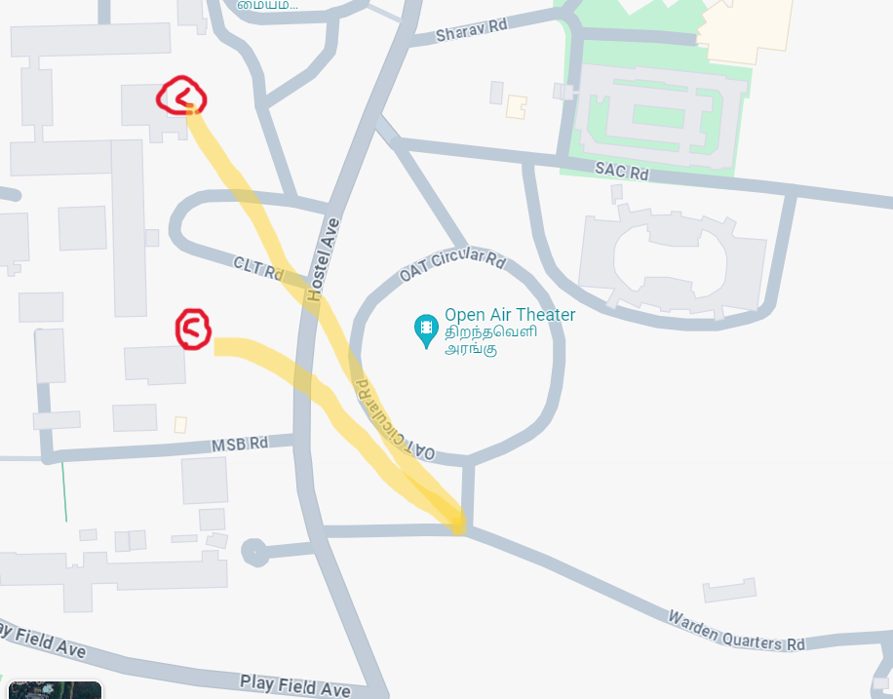
To ensure optimal user engagement, it is
crucial to design the website in a way that
is both comfortable and intuitive for users.
This encourages them to interact with the
website as intended.

Slide 6
Rules to create an interactive UI design
Hierarchy
-> Font Size and style
-> Colour
Layout
Alignment
Simplicity
Audience

Slide 7


🤢
😍

Slide 8
Hierarchy (font and colour)
Font and colour brings attention to the user
Bigger and bright coloured elements grabs attention towards them.
eg: clothing websites rate and add to cart options ,etc…

Slide 9
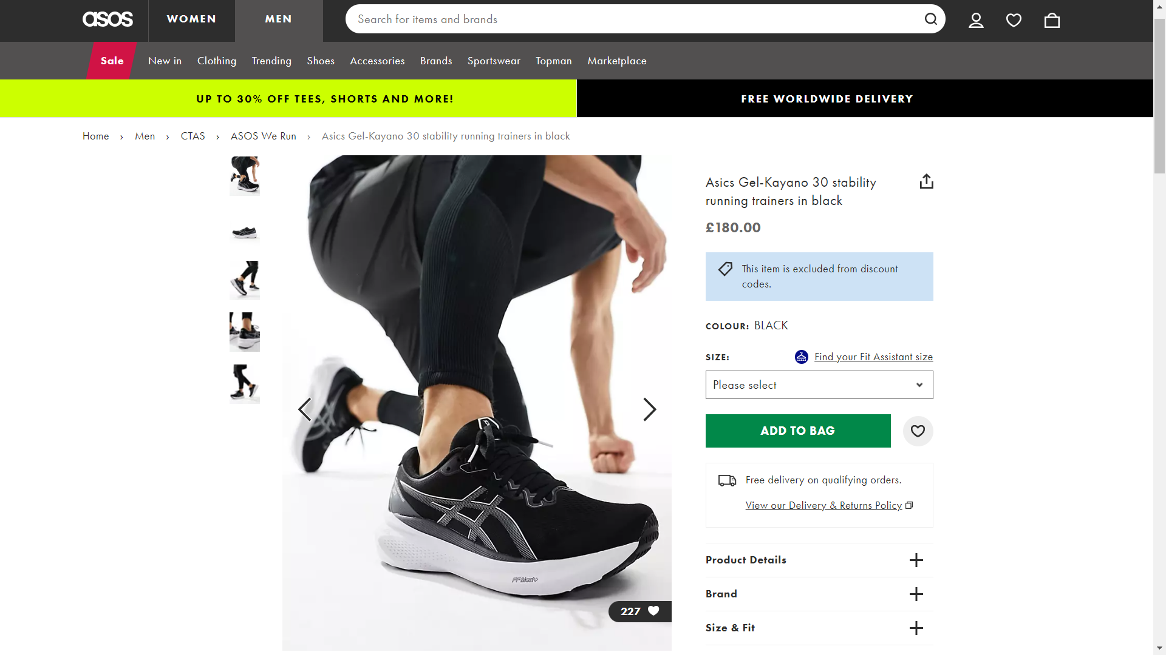
👀
👀
👀
👀

Slide 10
Hierarchy (size and colour)
Font and colour brings attention to the user.
Bigger and bright coloured elements grabs attention towards them.
eg: clothing websites rate and add to cart options ,etc…
Colour is one of the most important feature for a interactive design, so lets get learn about it.

Slide 11
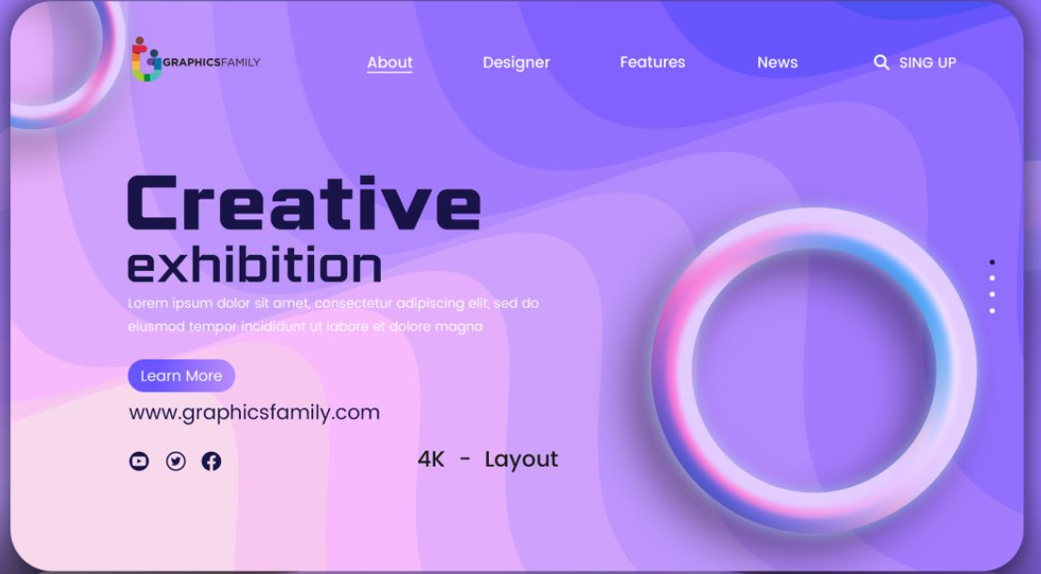




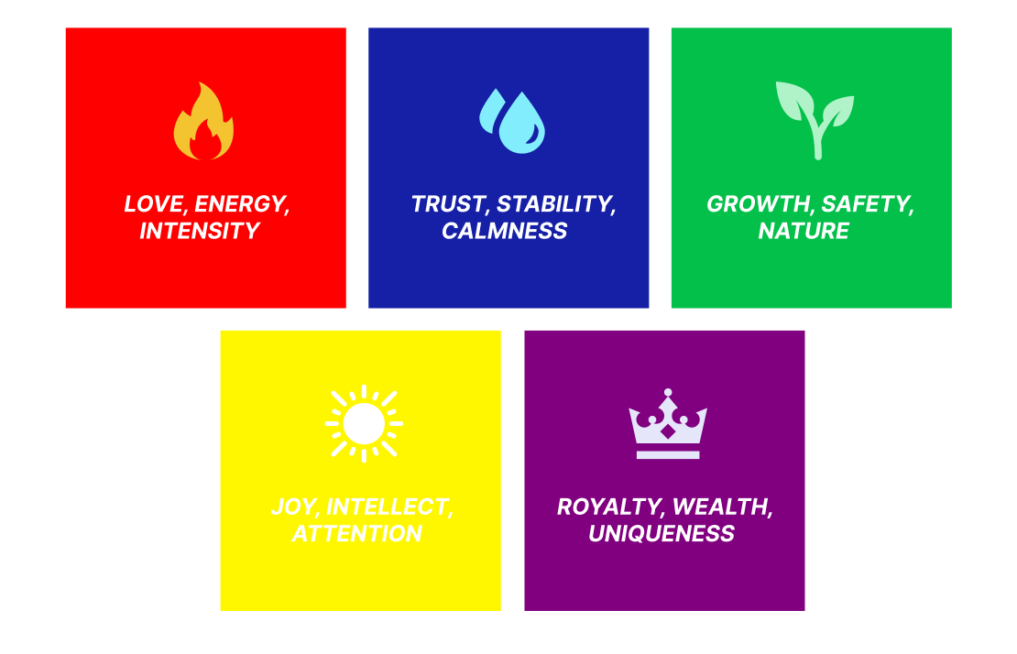
Colour theory

Slide 12
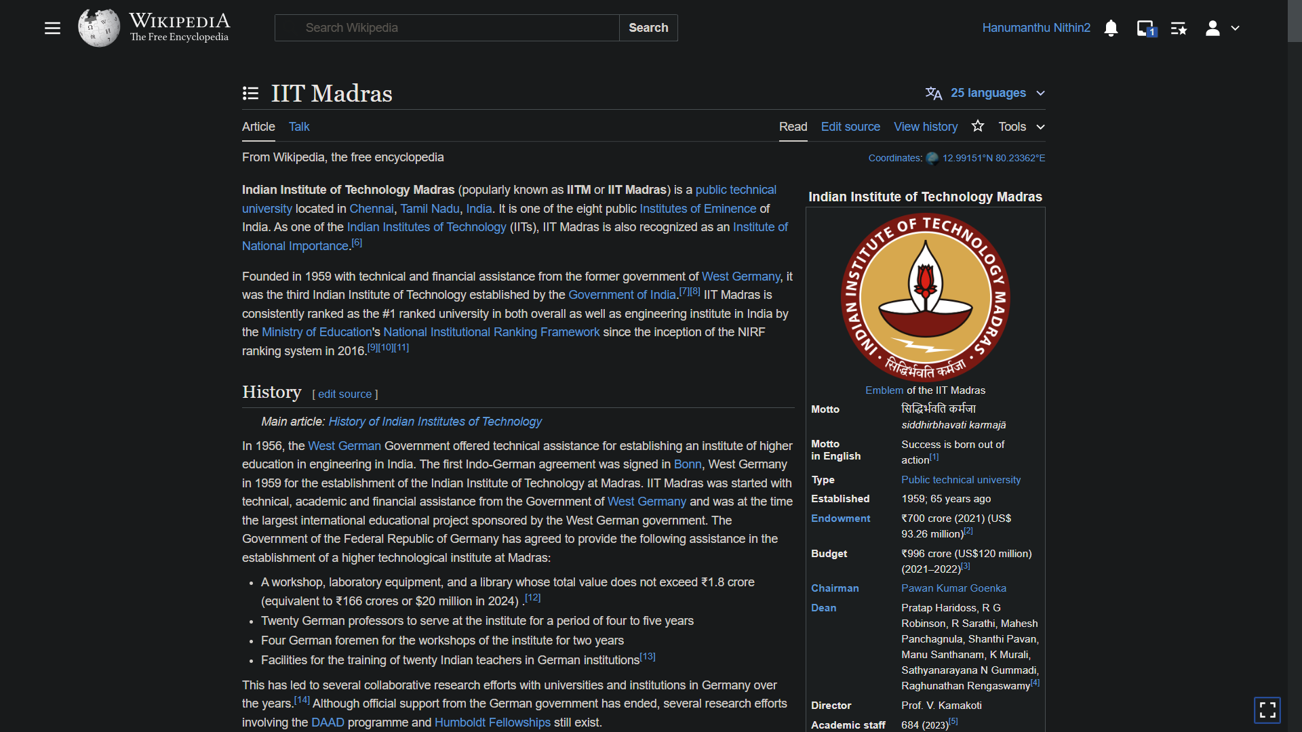
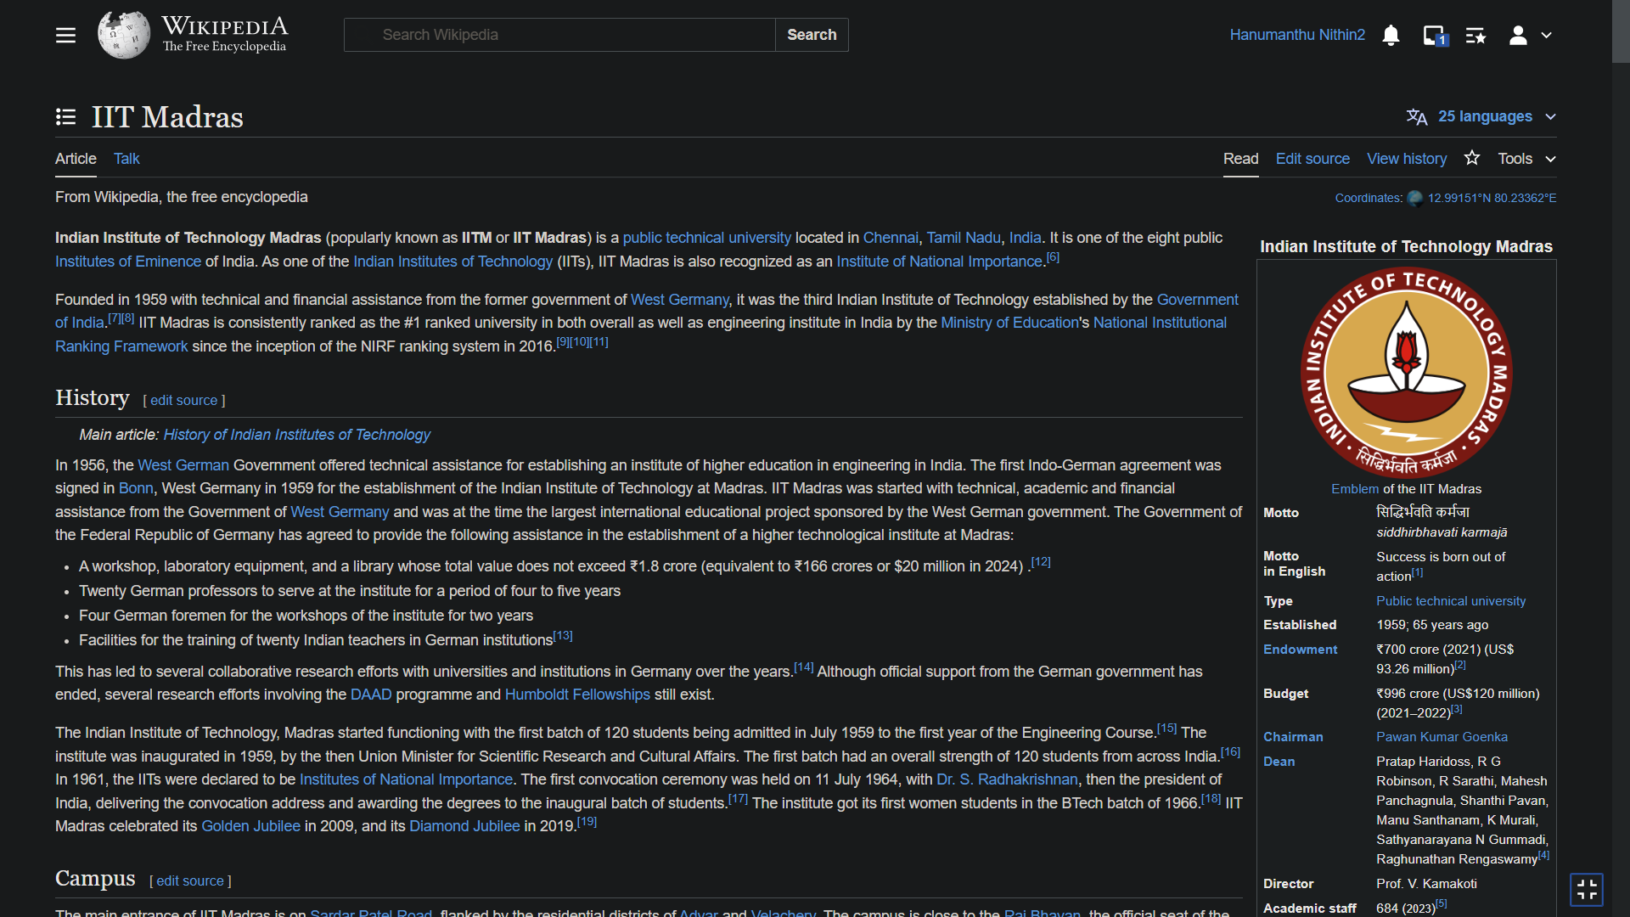

Slide 13
Layout
It is one the feature to make website attractive, it is the structure to make it look coherent to the website owners and also the audiences.
The line should not contain either more words or less words. An average of 40 to 60 characters per line is preferable.
The position of text, images, dashboard will come under this category.
The website should be responsive that means website can be viewed in desktop and also in mobile so the layout of both shouldn’t be same for a attractive design.

Slide 14
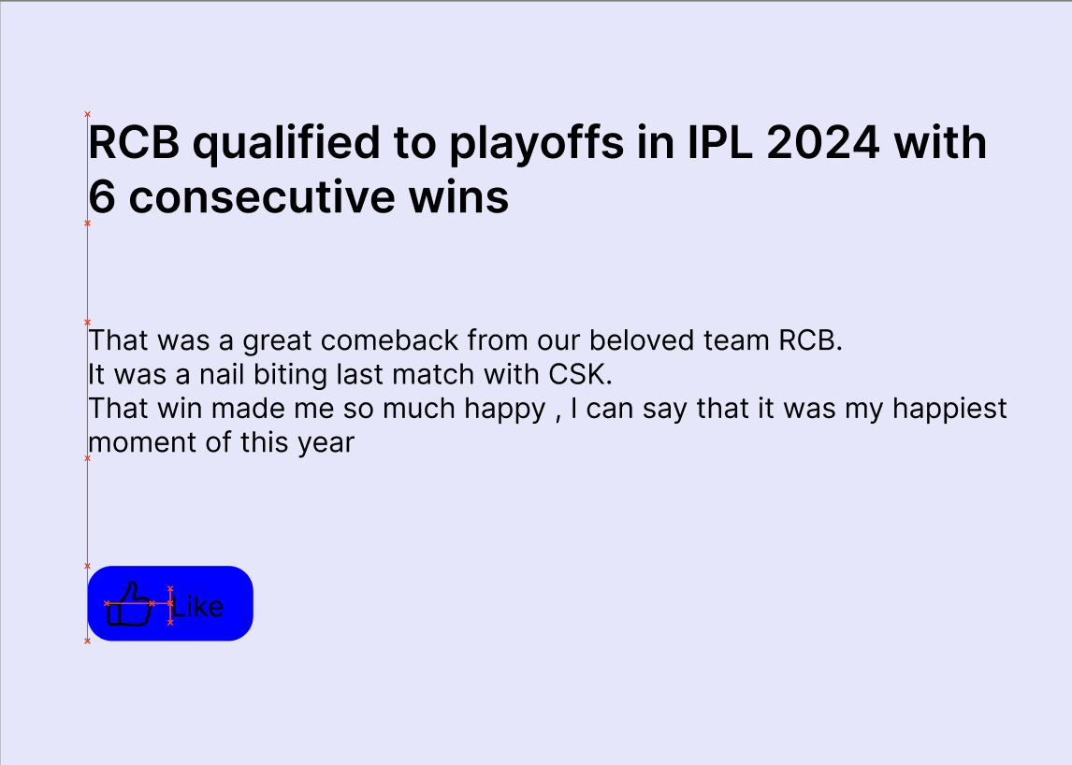
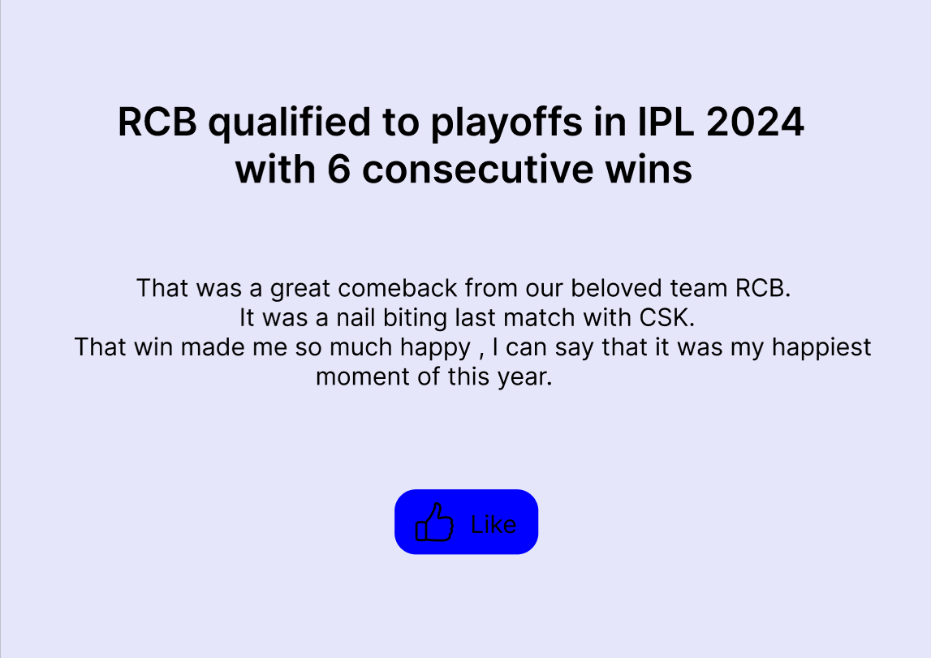


Alignment

Slide 15


Simplicity

Slide 16
Audience
There are few rules to ensure the effectiveness of a website, it's essential to consider the target audience, whether they are children, adults, professionals, or the general public.
There are specific guidelines to follow for each of these categories
Ensuring privacy and security to their account, making them trust you, checking the review about the websites and modifying it will give a friendly response.
Lets see few examples..

Slide 17

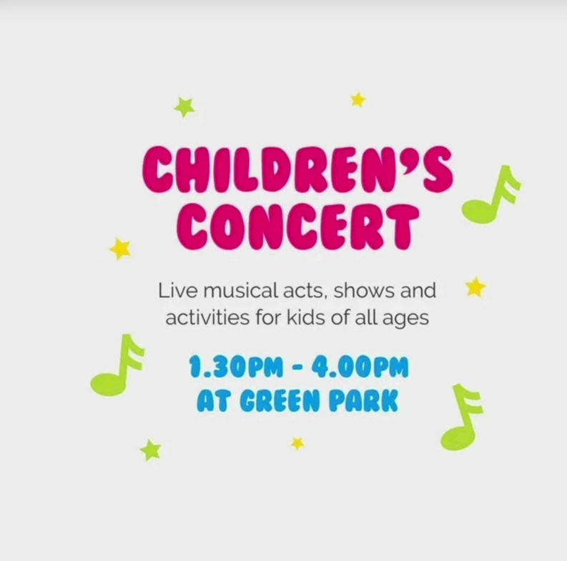
Audience

Slide 18
Rules to create an interactive UX design
Consistency
Reading patterns
-> F
-> Z
White space
Following latest trends
Ethical usage

Slide 19
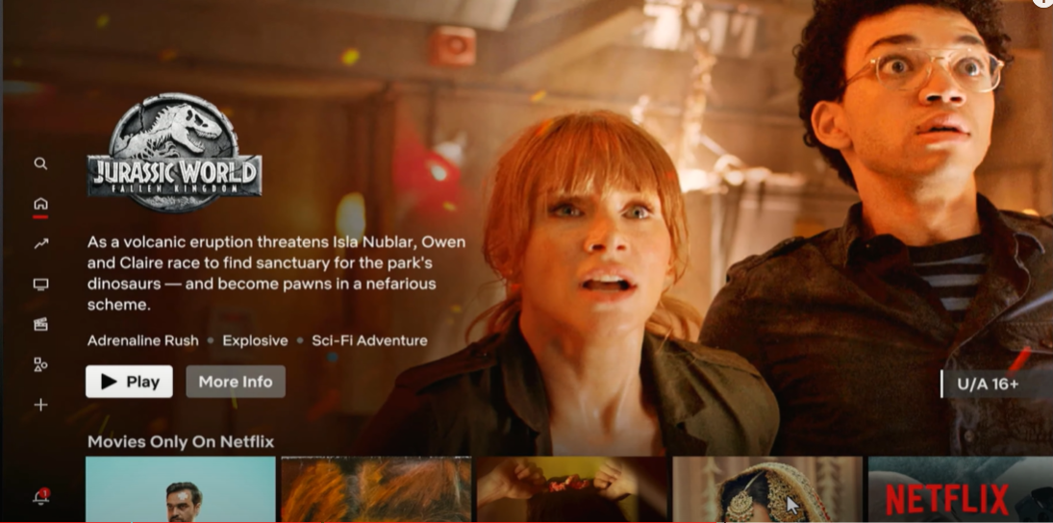
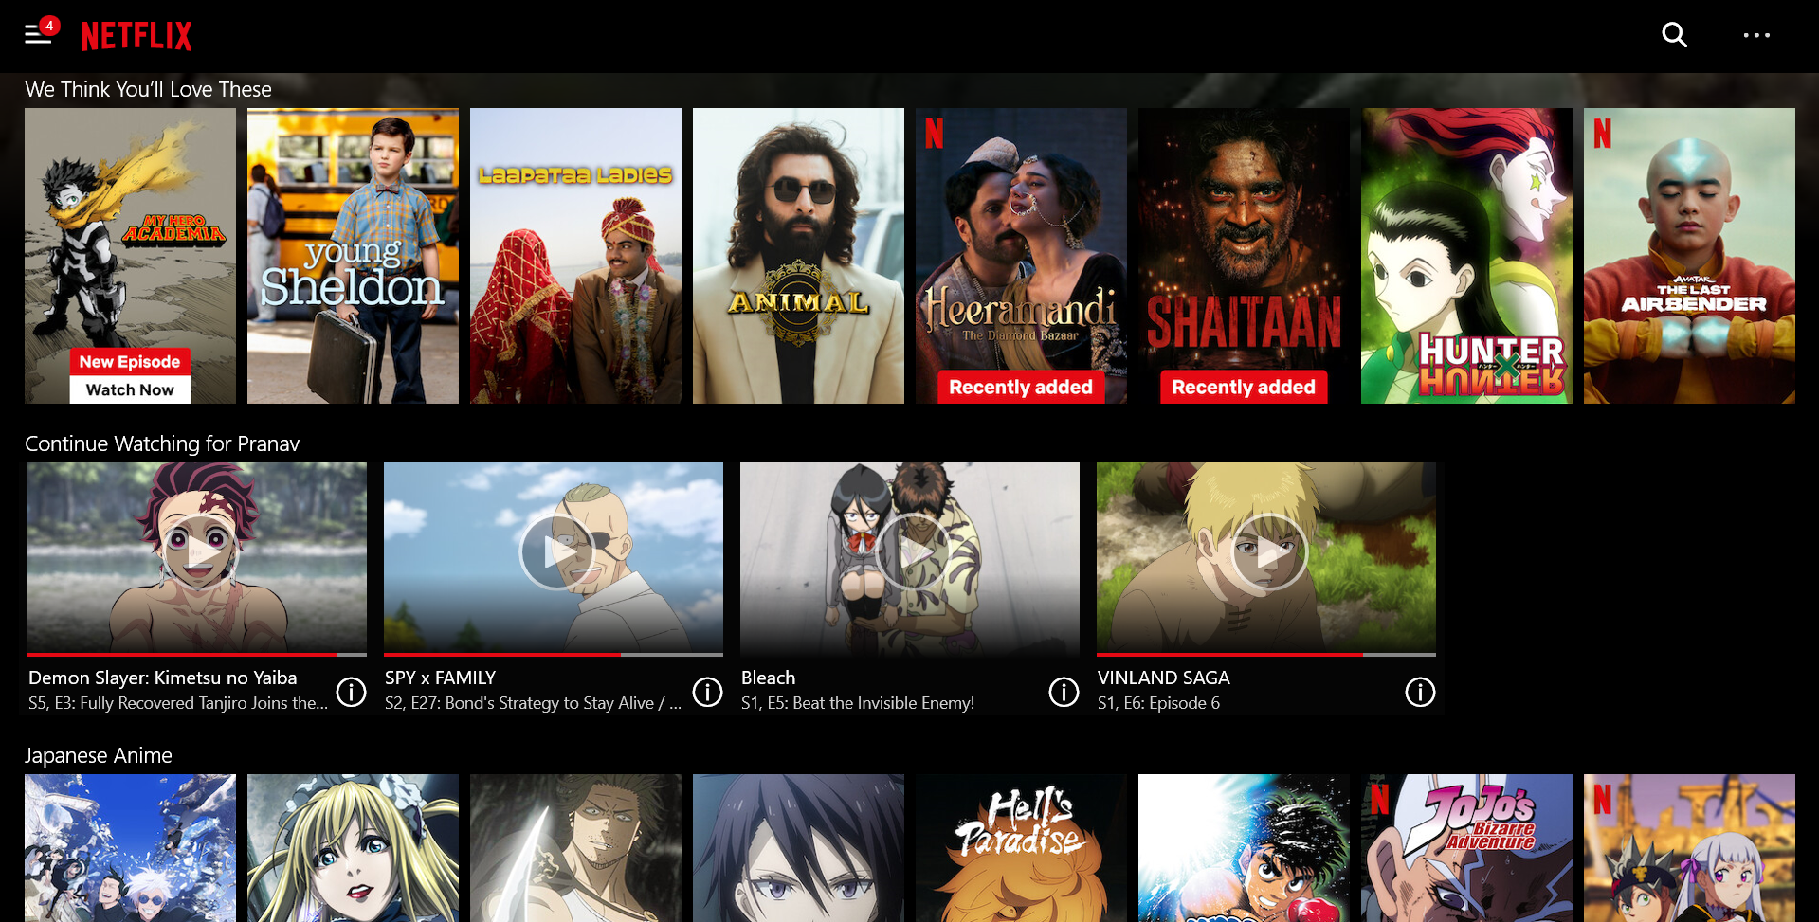
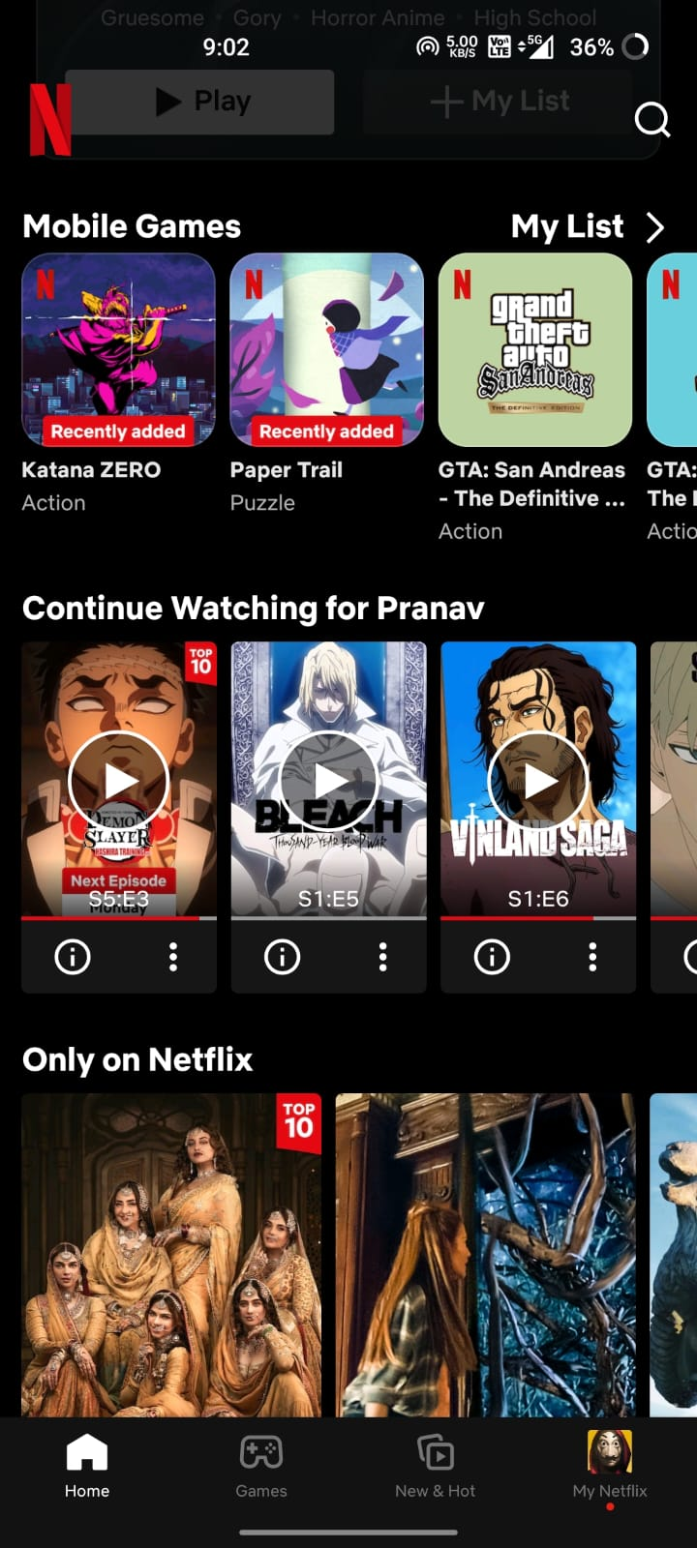
Consistency
Ensuring consistency throughout the website
will enhance user experience by making
navigation intuitive and interactions seamless.

Slide 20
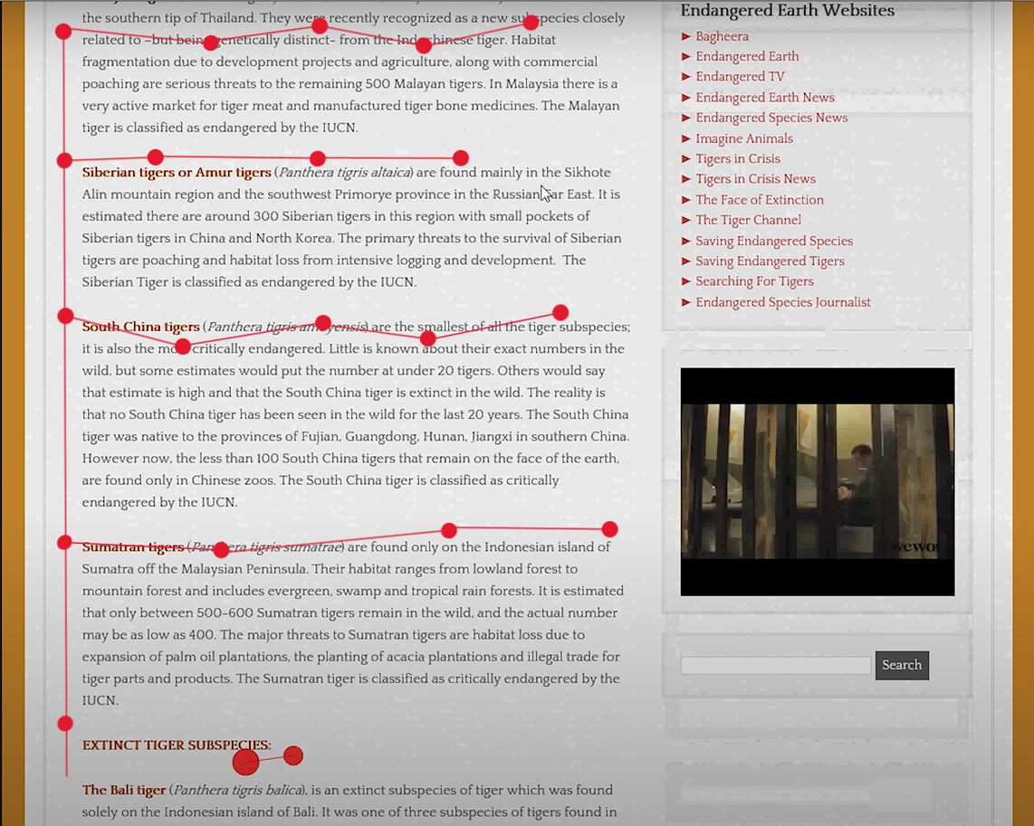
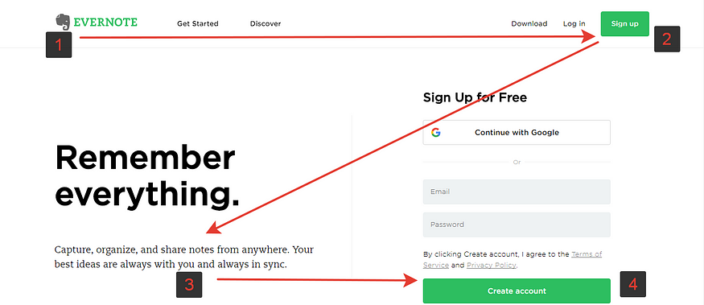
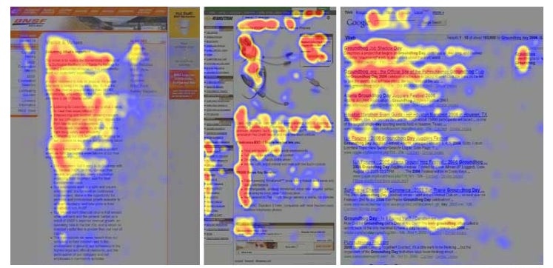
Reading Patterns
F Pattern
Z Pattern

Slide 21


White space
Showroom
General Store

Slide 22
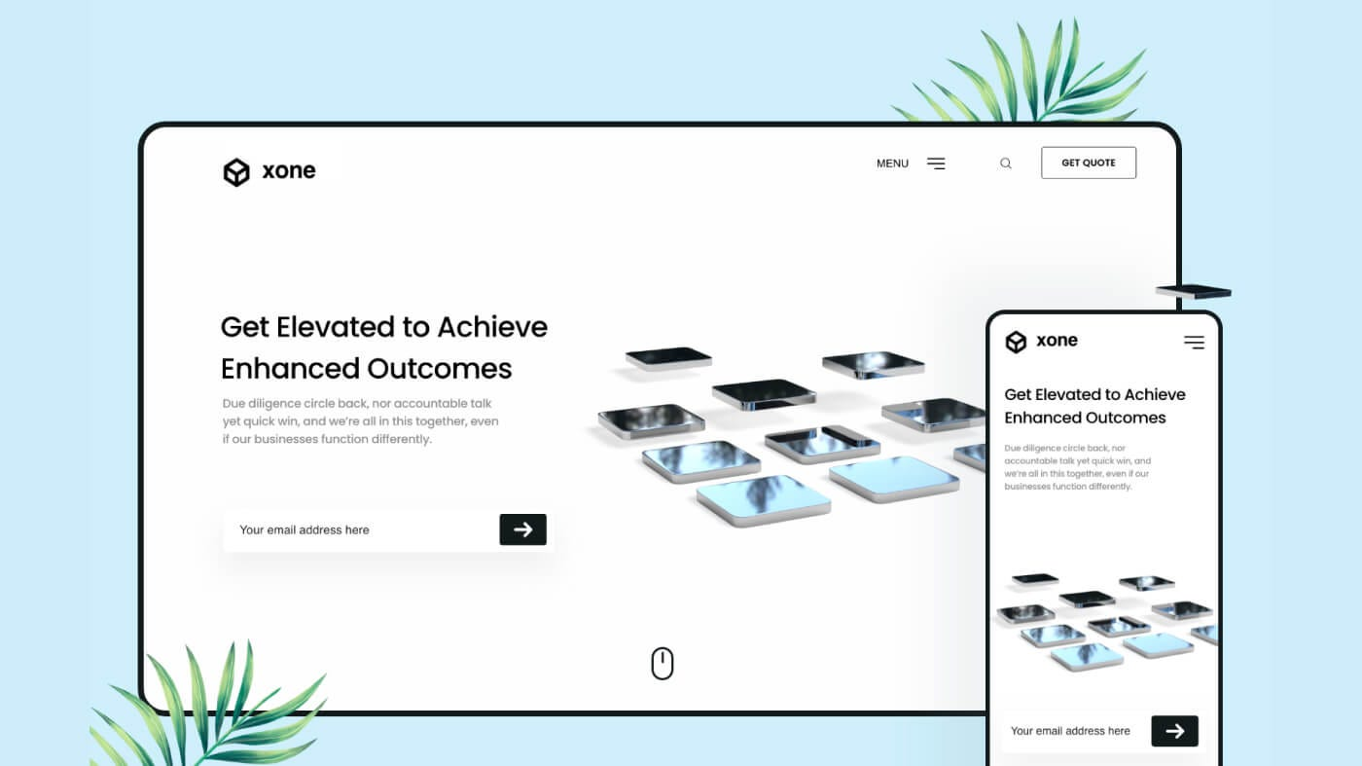
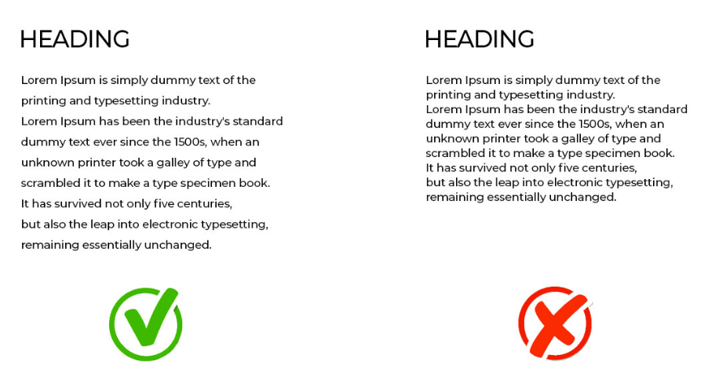

White space
White space improves readability
and comprehension
It shouldn’t be less or more

Slide 23
Trends
Dark mode, animations ,microinteractions ,3D effects, and many more are grabbing human attention these days.
These are making interfaces more engaging, intuitive and memorable .
Few examples of animations like
Hovering,
Transitions,
Instagram like animation, etc.. will be discussed soon in tutorial.

Slide 24


Ethical usage

Slide 25


Ethical usage
.
Always prioritize user interests by ensuring the
website facilities their tasks and meets their
needs efficiently. Never betray them.
.
Establish and maintain user trust by safeguarding
their passwords and personal information.
.
Ensure website accessibility for all users, including
those with disabilities.

Slide 26
Platforms to design
Until now, we have learned the principles of web design now its time to implement them.
There are many platforms to design
eg: Figma, Canva, Sketch, etc….
In this session you will learn about Figma and its tools.
Search Figma in the browser and sign up to practice.

Slide 27
What is Git?
Git is the most popular Version Control System(VCS).
VCS records changes made in the code over time in a special data base called repository.
Using VCS we can track history and work together.
VCS are of two types
Centralised and Distributed.
Git comes under Distributed VCS in which every member working for the project will have the copy of that project in their individual systems.

Slide 28

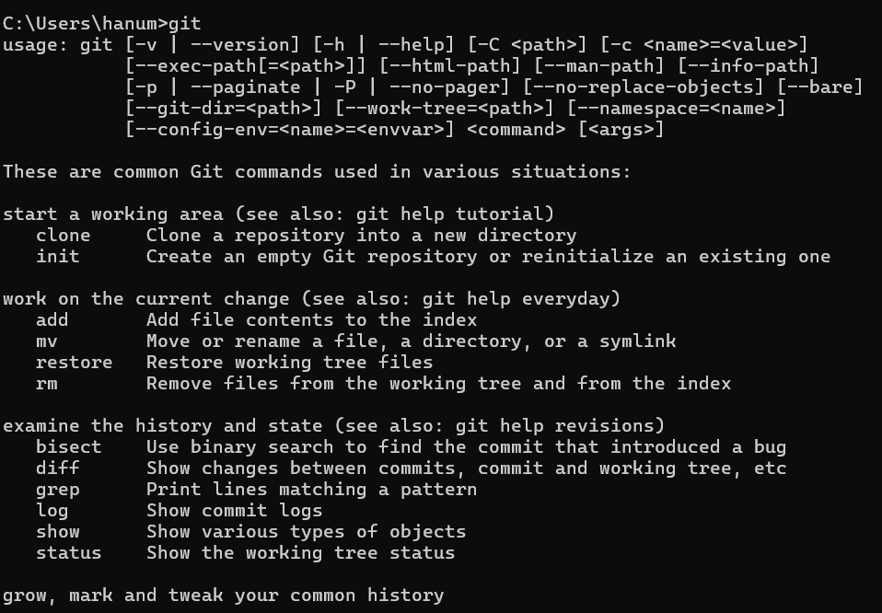
Installing Git
To install Git, visit git-scm.com and download the appropriate version for your operating system, whether it is Linux, Windows, or macOS.
Click on next button continuously to the end to install Git.
To check whether git is installed or not, open command prompt and enter git.

Slide 29
Commands in command prompt & git
Creating a folder and file & initialising a repository.
Git workflow.
Staging files.
Committing changes.
Removing files.
Renaming or moving files.
Viewing the history and commits.
Restoring a file to an earlier version.

Slide 30
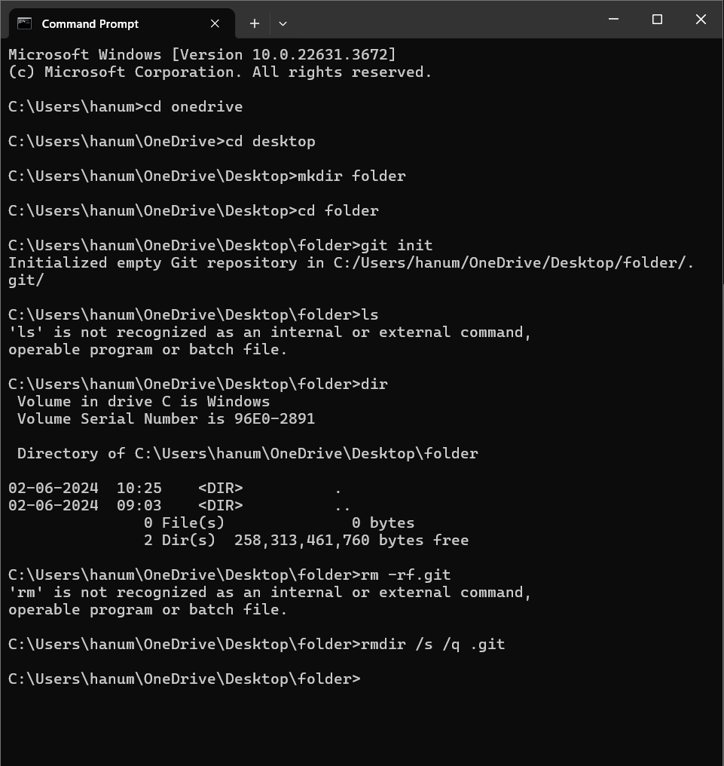
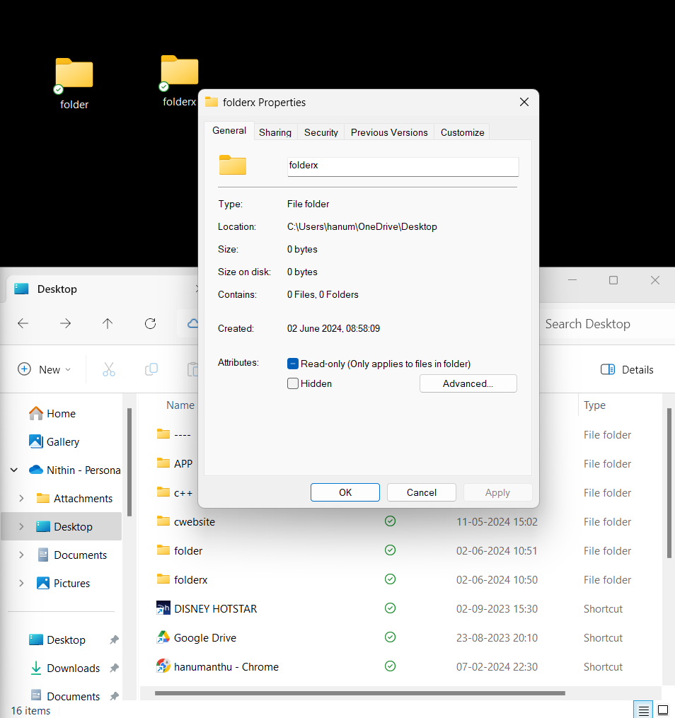
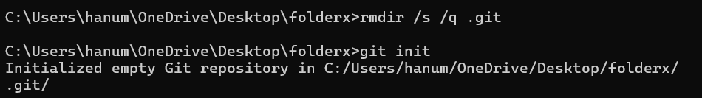
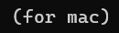
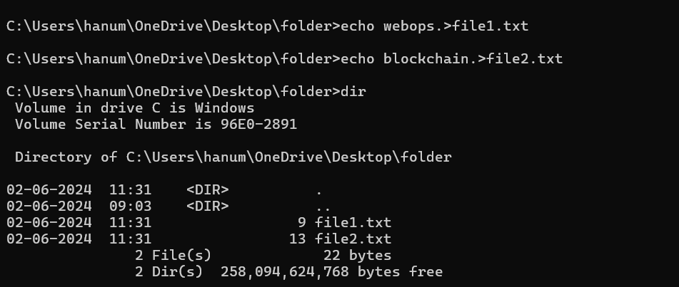
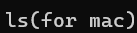
Creating a folder and file & initialising a repository

Slide 31
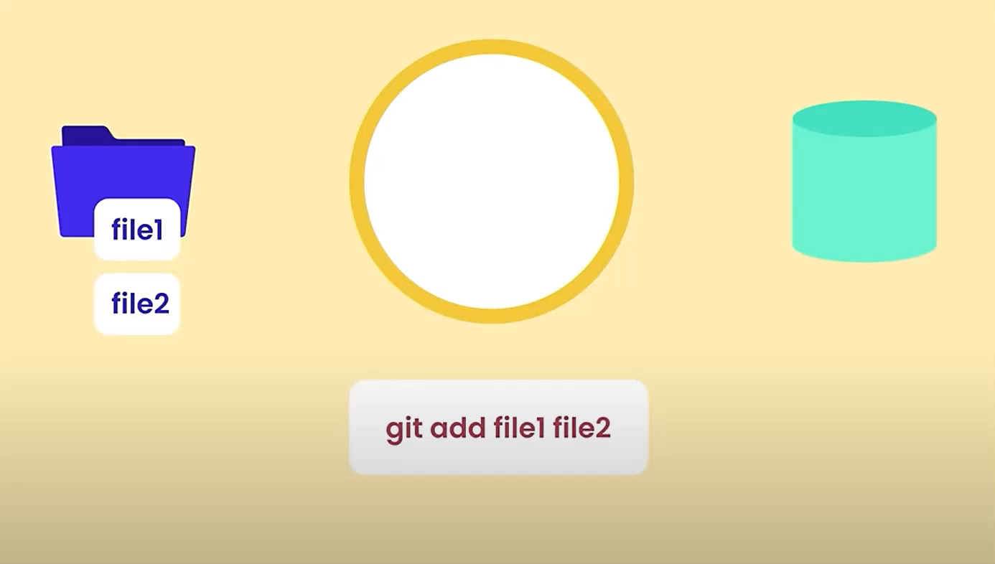
Git workflow
Working
directory
Local
repository
1.Create file1 and file2
2.Add them to stagging area
3.Commit them to local repo
4.Modify file1
5.Send it to local repo
6.Delete unwanted file2
7.Change file1 name
8.Delete file1(unfortunately)
9.Restore it
Stagging area

Slide 32
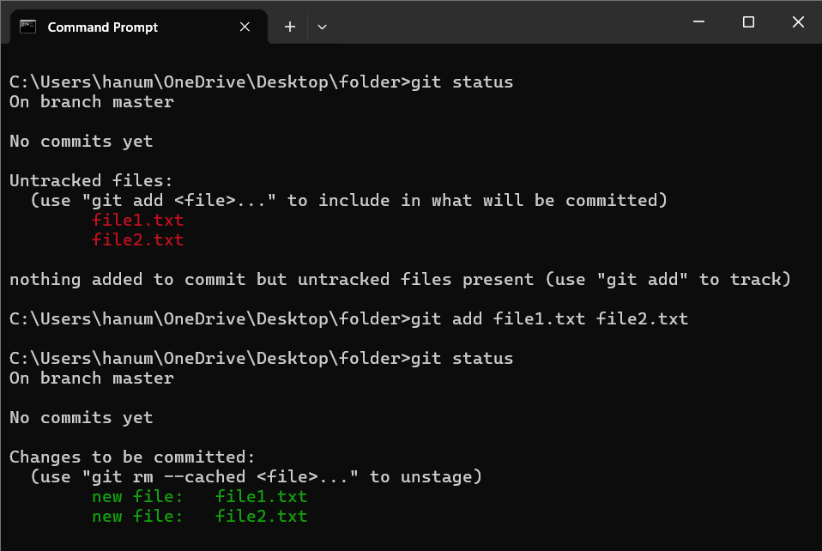
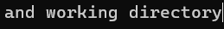
Staging files

Slide 33
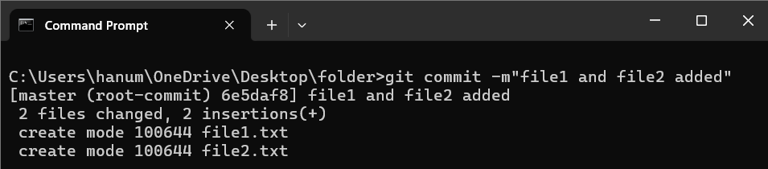
Committing changes

Slide 34
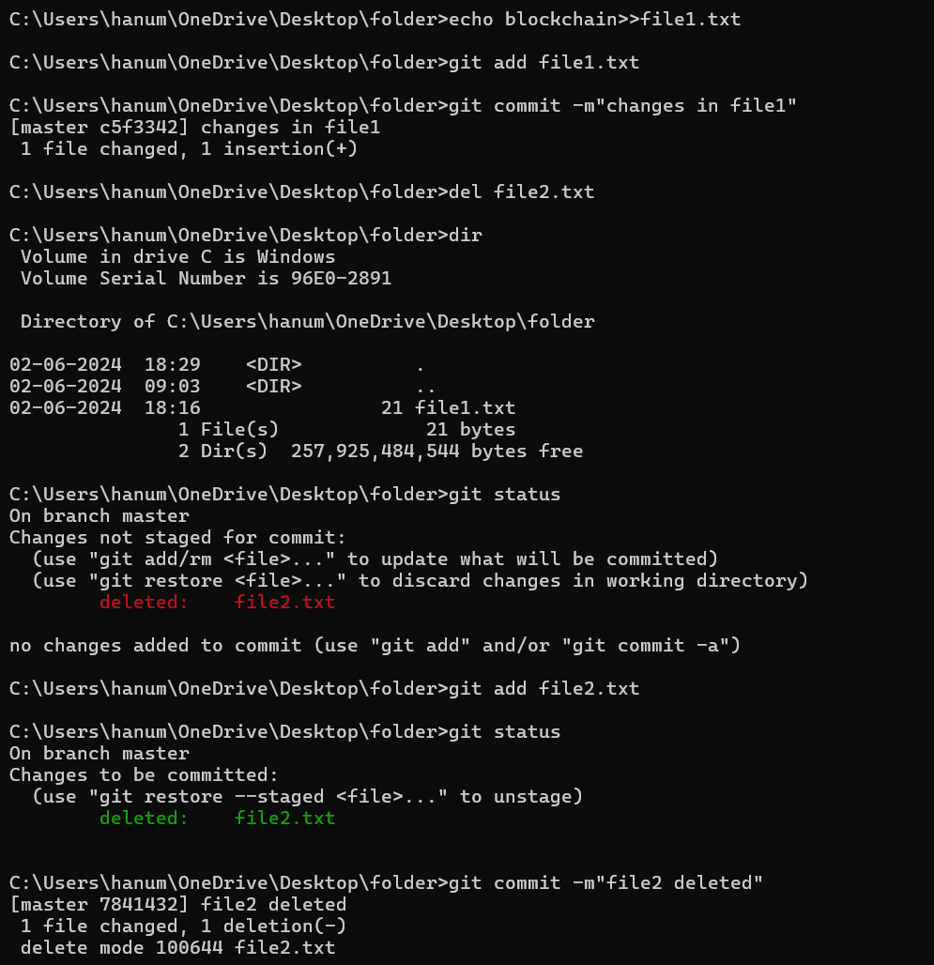
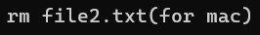
Removing files
.
The red text indicates the change is not done in
staging area.
.
To delete file from staging area we need to enter
git add file2.txt.
.
To directly remove the file from staging area use
the following command.

Slide 35
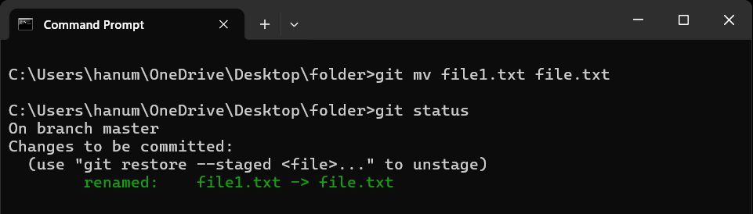
Renaming or Moving files
Don’t forgot to commit

Slide 36
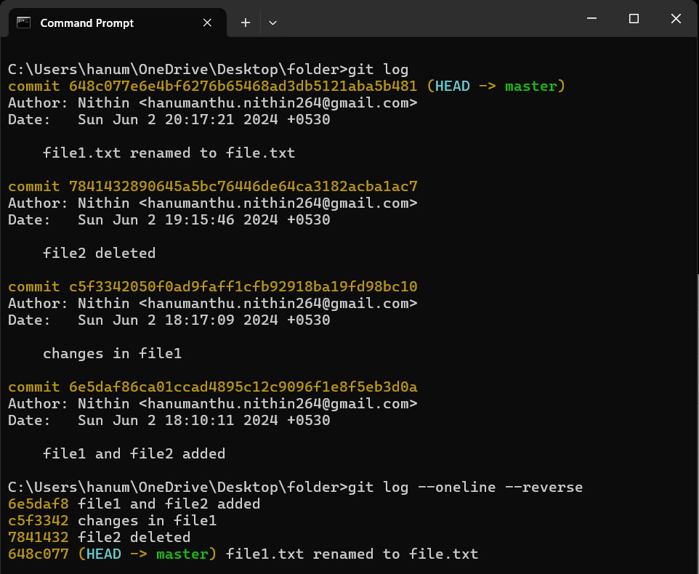
Viewing history and Commits
Why I used reverse is it’s easy to see our
changes from top to bottom rather than
from bottom to top

Slide 37
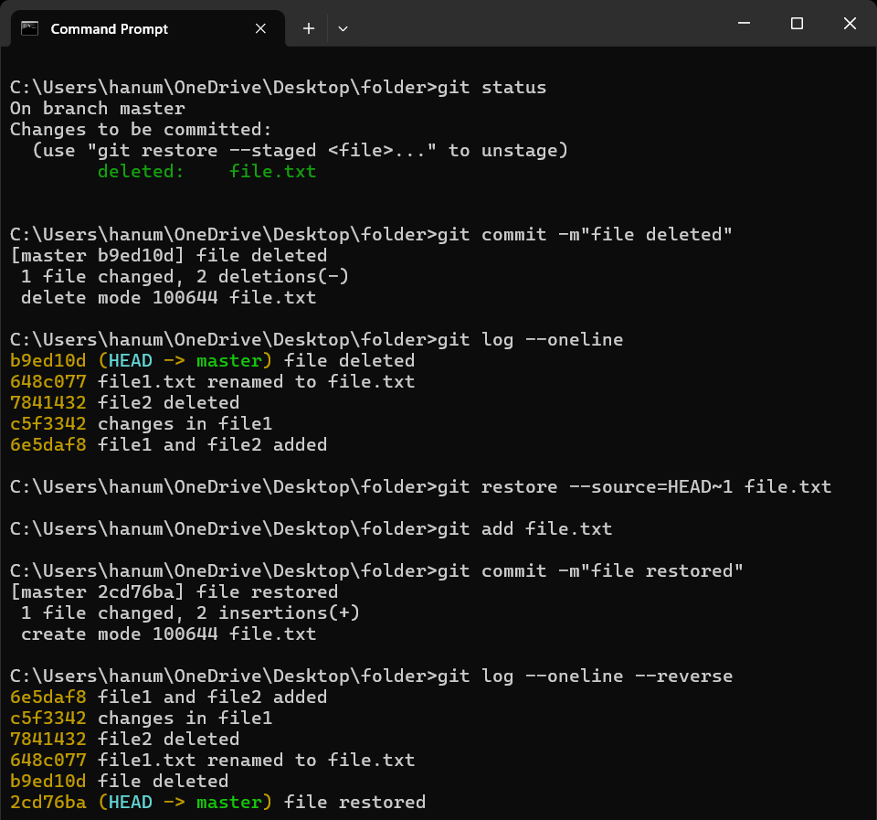
Restoring a file to its earlier version
What is a branch?
Branching means diverging from the mainline
and continue to work separately without messing
with the mainline
We will learn more about it shortly

Slide 38

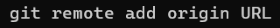
What is GitHub
?
GitHub is a developer platform that allows developers to create, store, manage, and share their code.
How to push code or changes & what is fork?
Hosting a project and merging & pull request to a existing project
Browse GitHub and signup
These are the commands you will learn shortly

Slide 39
Hosting a project and merging & pulling request
I created 2 files hi.txt and bye.txt and modified my hi.txt file from “hi” and “hello” to “hi”, “hello” and “namskar”. People can see my repo.
One of my Japanese friend saw my repository in GitHub and want to add “konnichiwa” in my hi.txt file.
Now I have to merge(update) his changes in my repository.
He does not have access to my repo how he can add ?
What if he damages my existing repo?
If his change(or code) is good how can I update this in my repo?

Slide 40
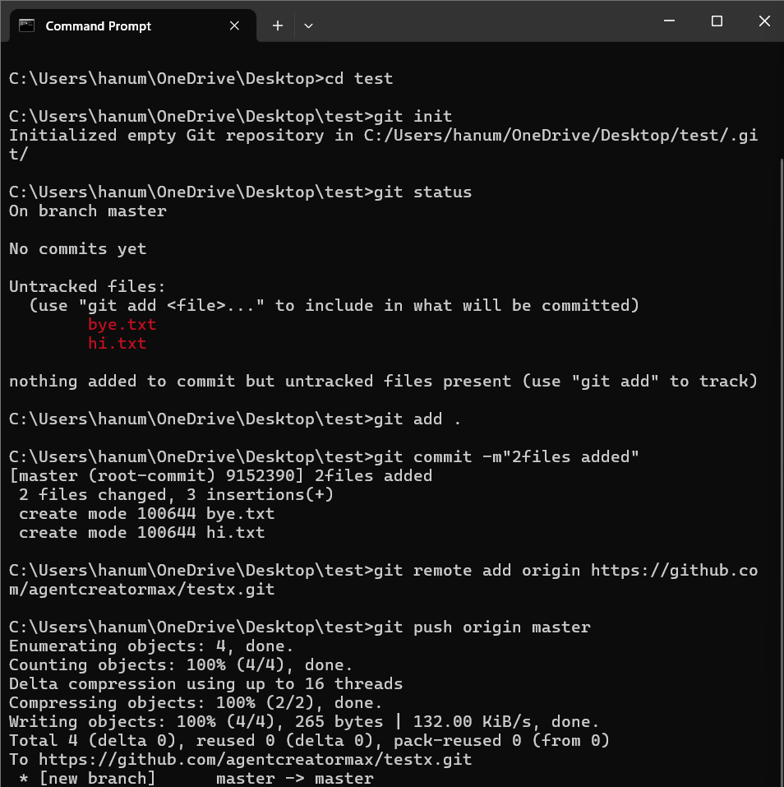
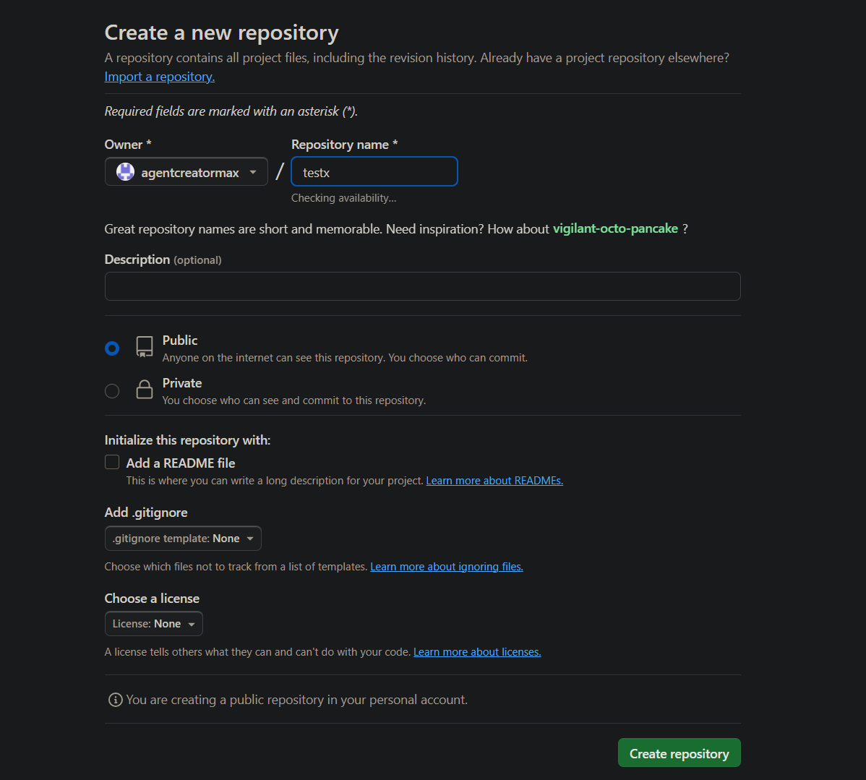
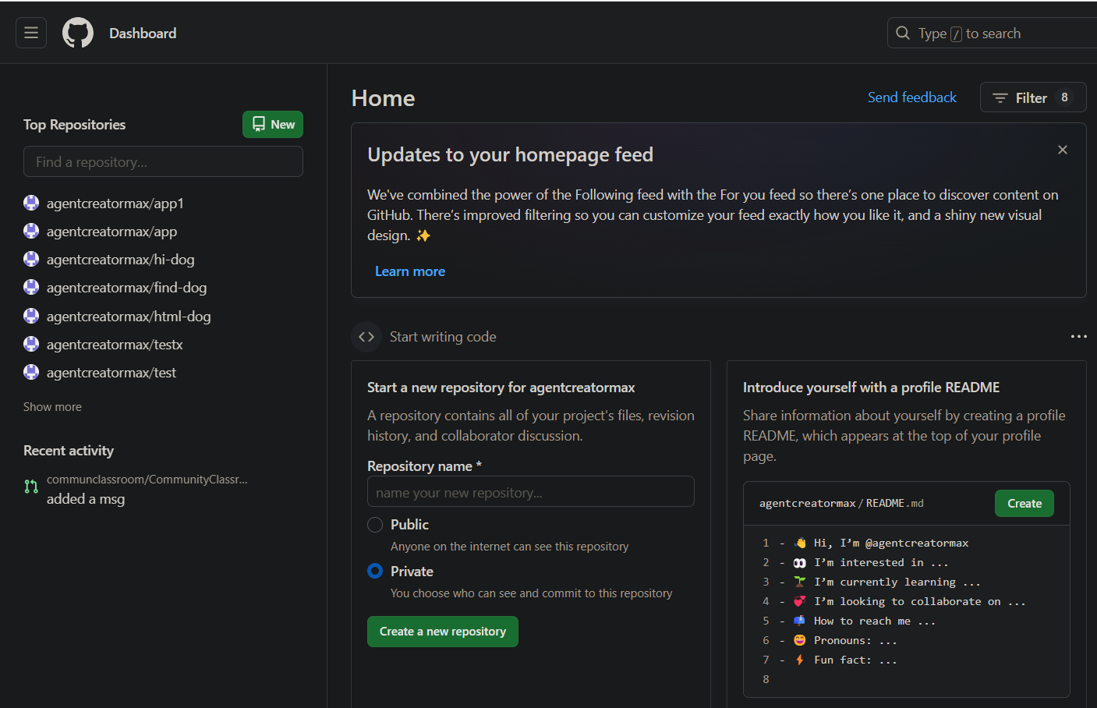
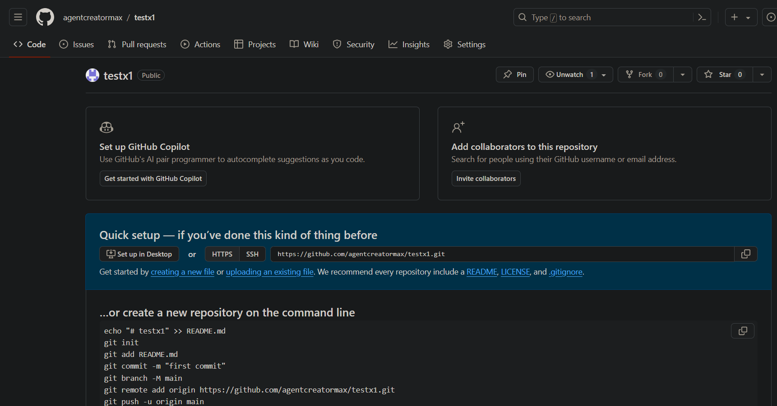

Slide 41
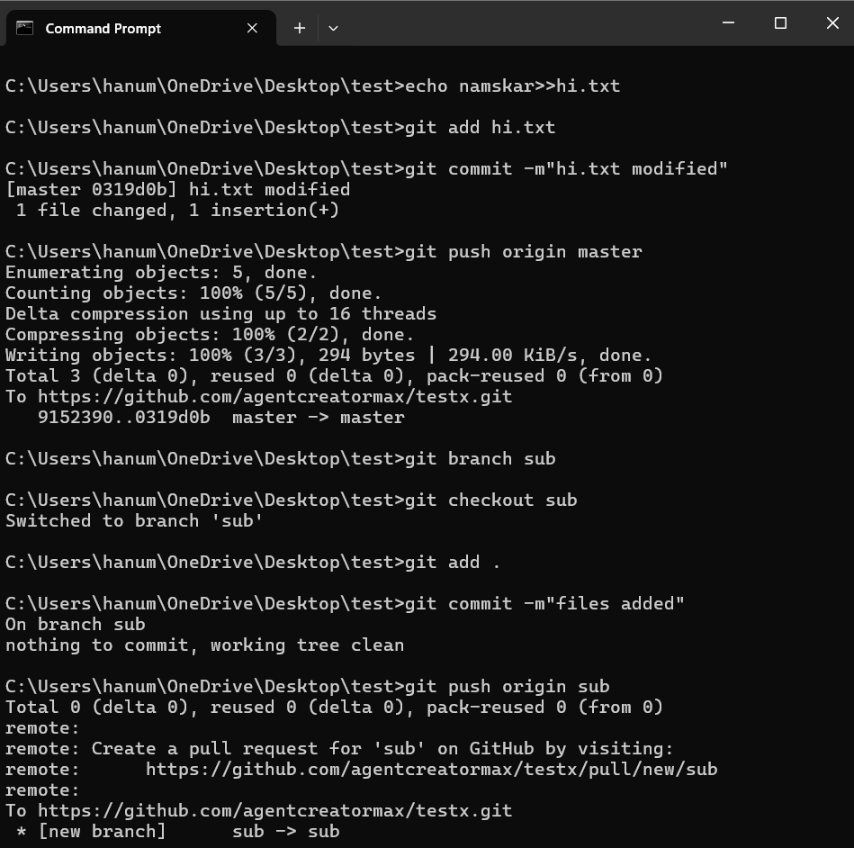
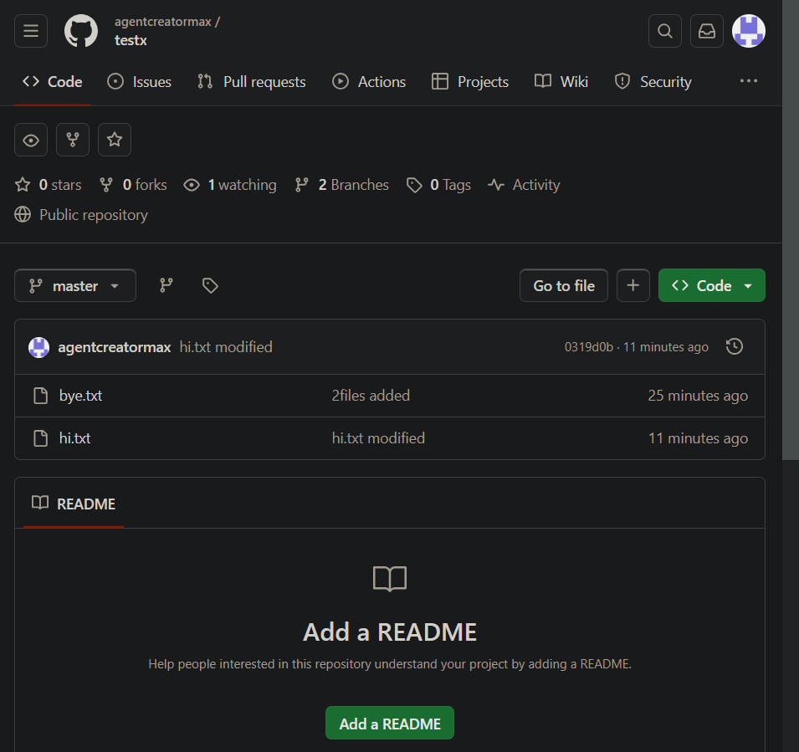

Now, he will fork your repo into his system and
click on he will copy that url and
in his cmd prompt
Fork means copying the files from project
to your working directory

Slide 42
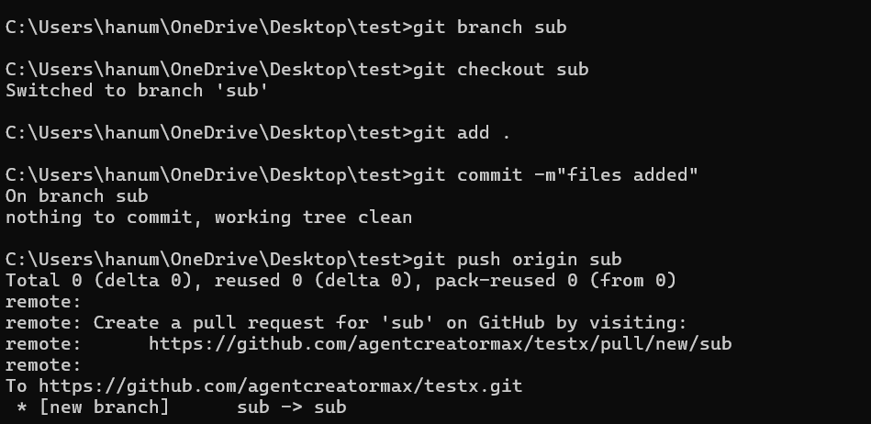
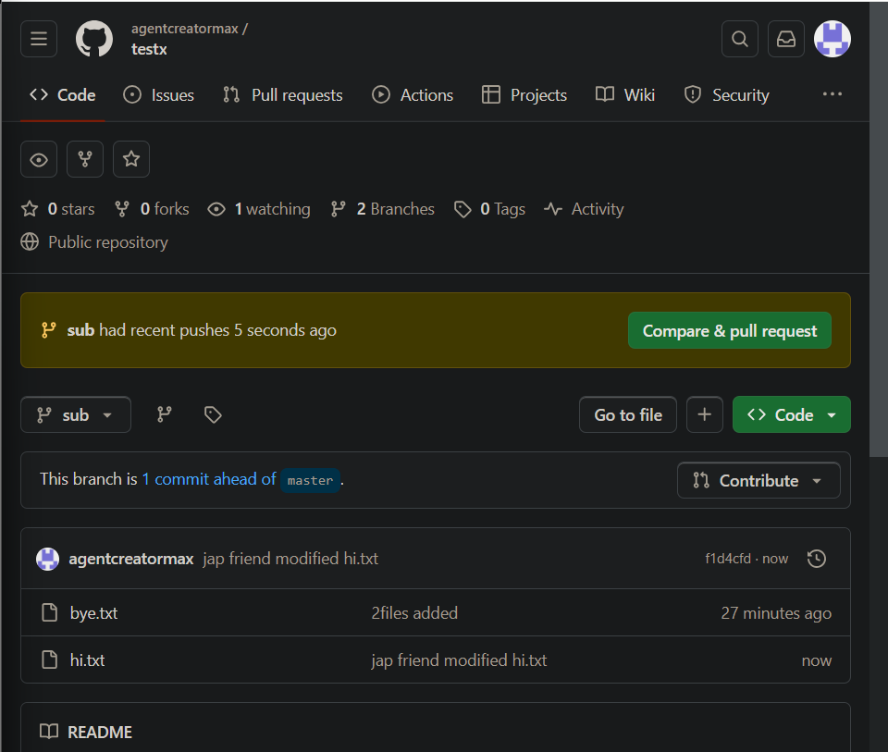
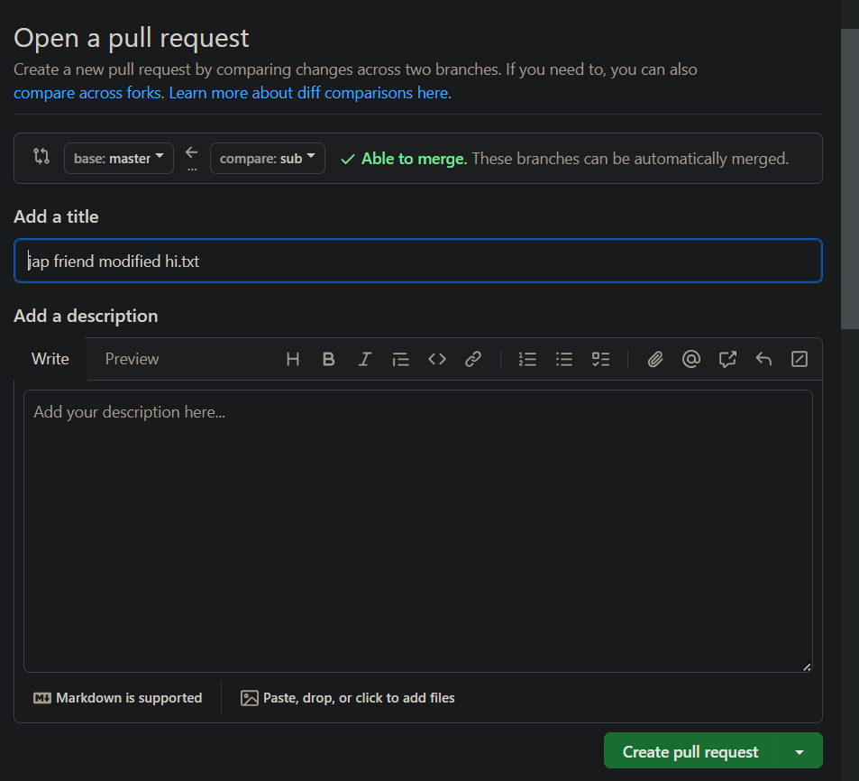
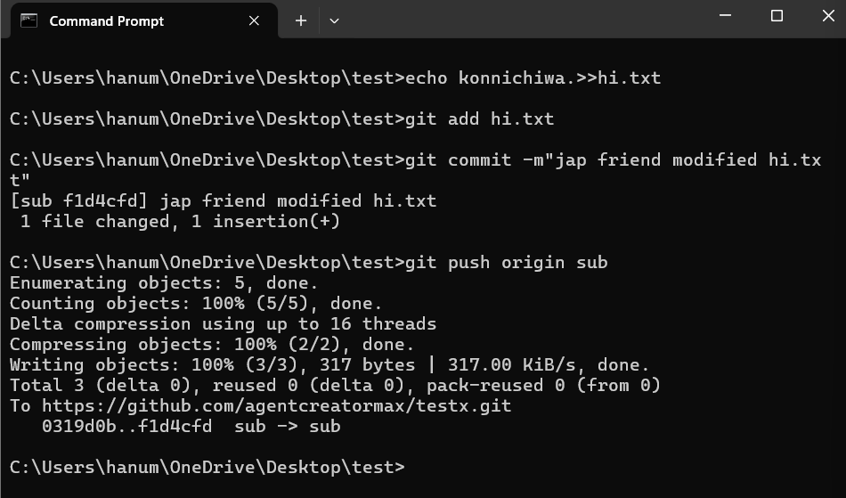

Slide 43
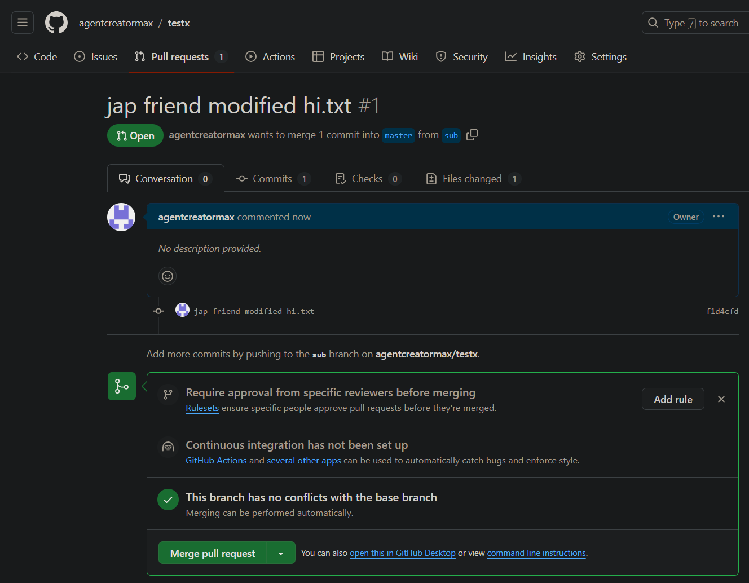
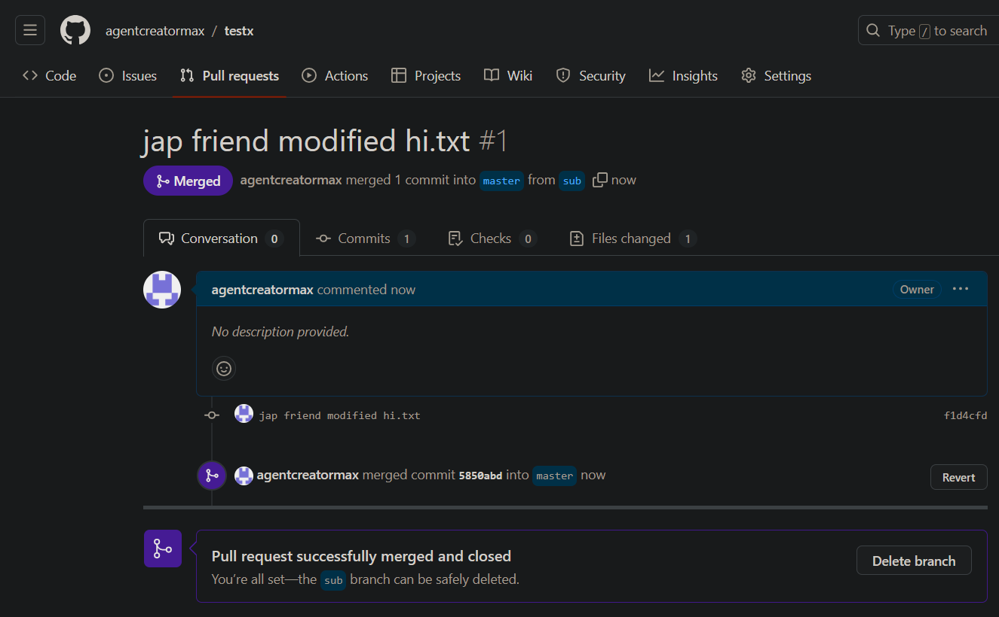

Slide 44
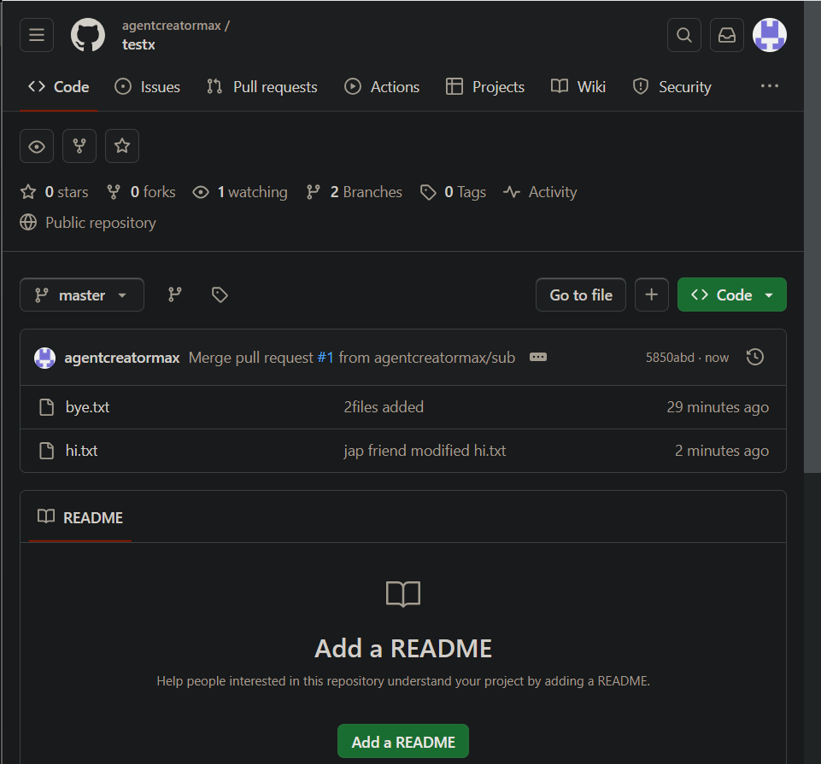
Previous master branch
New master branch

Slide 45

Questions
Prepare your own Figma design on InstiOLX with a login page and a home page.
Use icons
Prepare your own logo
Use atleast 3 different animations

Slide 46

Thank you

